Slide 1
Azure Data Catalog
Pilot project training

Slide 2

Recognize Any of These Challenges?
You spend more time looking for data,
than you do analyzing it
Data is sitting in multiple sources, but no insight into which data sits where
Many different data ecosystems across our enterprise, but no way to share data artifacts across them
Need data consumption in multiple different tools, but no common way to enable discovery and access to data sources across them
We are busy re-producing data assets that already exist
No way of tracking usage of our BI and Analytics assets
Notes:
Use this slide as a general introduction to the business benefits of Azure Data Catalog. This helps your audience quickly see the benefits of Data Catalog.

Slide 3
What is Azure Data Catalog?
An enterprise-wide catalog in Azure that enables self-service discovery of data from any source
A metadata repository that allow users to register, enrich, understand, discover, and consume data sources
Notes:
Use this slide, along with your knowledge of Data Catalog, to discuss what Azure Data Catalog is. To learn more about what is Azure Data Catalog, see https://azure.microsoft.com/en-us/documentation/articles/data-catalog-what-is-data-catalog.

Slide 4
Enabling the Entire Enterprise Data Ecosystem
Discover
Understand
Consume
Contribute
Search
Browse
Filter
Metadata
Experts
Context
Your data
Your tools
Your way
Tag
Document
Publish
Analyze
Notes:
Here are some talking points:
Data Catalog enables us to get the most value from our existing information assets.
Data assets are easily discoverable and understandable by the users who need the data.
Find data that matches your needs, and understand the data to evaluate its fitness for purpose.
Consume that data by opening the data source in your tool of choice.
You can contribute to the catalog, by tagging, documenting, and annotating data sources.
Data sources can be understood, and consumed by the community of Data Catalog users.

Slide 5
Publish
What Can I Do With It?
Publish data
Consume data
Discover
Register data sources
Search - Browse
Enrich
Crowdsource
Annotate
Get context – Identify Intent
Notes:
Here are some talking points:
Publish - Registration stores key information (metadata) about the data source– such as names, types of data, and location of data – in the catalog.
Enrich - Annotations enhance information about data sources.
Discover - Data Catalog has multiple ways to Search data assets.

Slide 6
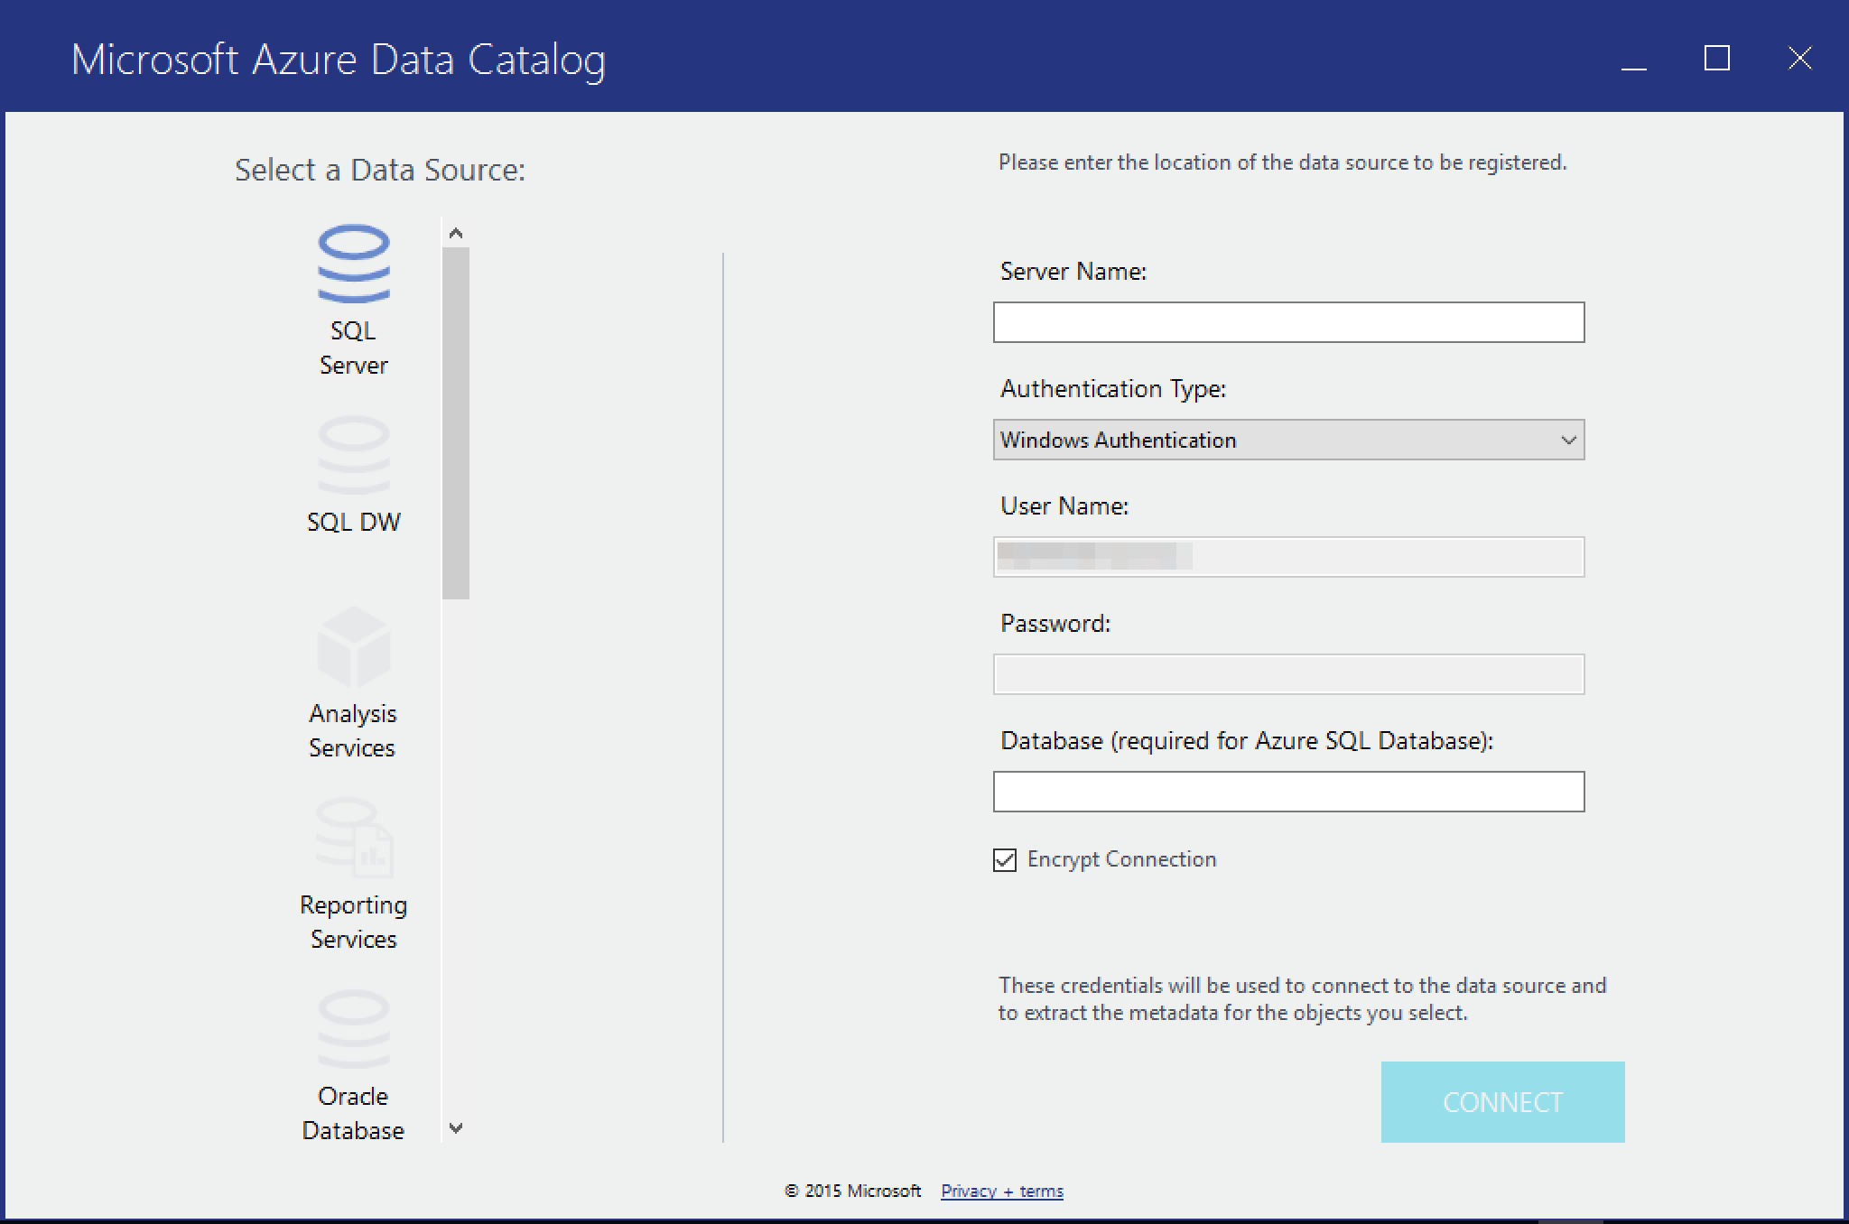
Register data sources
Publish
Registration stores key information (metadata) about the data source– such as names, types of data, and location of data – in the catalog.
Only information about the data source is stored in Data Catalog.
Use the Data Source Registration tool to register data sources.
Learn how
Register data sources
Notes:
Use this slide to discuss how to Register.
You might want to mention:
The actual data remains securely stored in the data source.

Slide 7
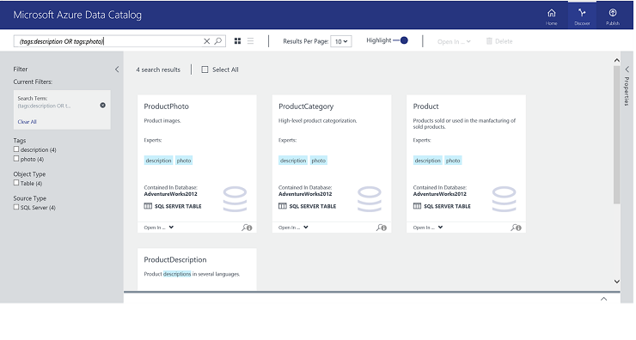
Browse and search data sources
Discover
Data Catalog has multiple ways to discover data assets, including
Simple keyword search
Interactive filters
An advanced search syntax for “power” users.
Learn how
Discover data sources
Notes:
Use this slide to discuss how to Search.
Here are some talking points:
A key aspect of data discovery is the ability to search for data sources.
Data Catalog has a powerful search syntax that enables you to easily build queries that return the data you need.
Browse data sources in card view or in a list.
Learn more about Data Catalog Search syntax (https://msdn.microsoft.com/library/azure/mt267594.aspx).

Slide 8
Some example queries
Discover
Technique | Use | Example
Property Scoping | Return data sources where the search term matches a property | name:product
Logical Operators | Broaden or narrow a search using Boolean operations | finance NOT corporate
Grouping with Parenthesis | Group parts of the query to achieve logical isolation, especially in conjunction with Boolean operators | name:product AND (tags:illustration OR tags:photo)
Comparison Operators | Use comparisons that have numeric and date data types | creationTime :> 11/05/14
Notes:
Use this slide to illustrate that with Azure Data Catalog you have various search options.

Slide 9
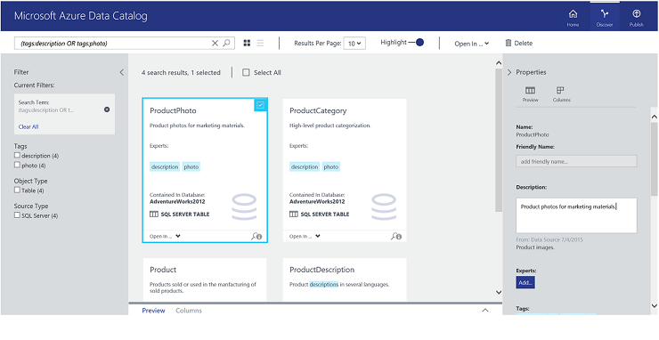
Annotate data sources
Enrich
Annotations enhance information about data sources so that they are easier to discover and understand.
Any Data Catalog user can provide annotations, so it’s easy for every user with a perspective on the data to share it.
Learn how
Annotate data sources
Annotation
Notes:
Use this slide to discuss how to Annotate.

Slide 10
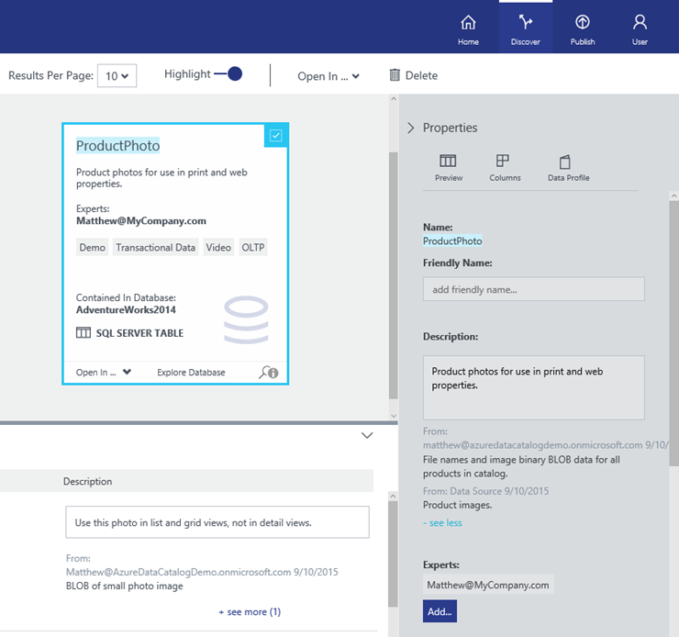
Crowdsourcing metadata
Crowdsource
Crowdsourcing allows any experienced user (or subject matter expert) to add tags, descriptions, and other information.
We can capture knowledge about data sources in a central location.
Experts can add the intent which adds business context to data sources.
Learn how
Crowdsource data sources
Expert Annotation
Notes:
Use this slide to discuss how to Crowdsourcing.

Slide 11
Conclusion
Azure Data Catalog is a fully managed service in Azure and an enterprise-wide metadata catalog that enables self-service data source discovery.
With Data Catalog, you register, discover, annotate, and connect to data assets.
Data Catalog is designed to manage disparate information assets to make them easy to find, enabling you to understand data assets you find, and to connect to these data assets, reducing time to insight and increasing the value organizations.
To learn more, see Microsoft Azure Data Catalog.

Slide 12
Our project goals
Notes:
Use this slide to list your project goals.

Slide 13
What’s next
Pilot team member expectations
Pilot participant homework
Schedule for reviewing data source annotations
Notes:
Use this slide to end your training with action items.
For example, each .pilot team member needs to register or annotate at least one data source they have used.

